Slide 1

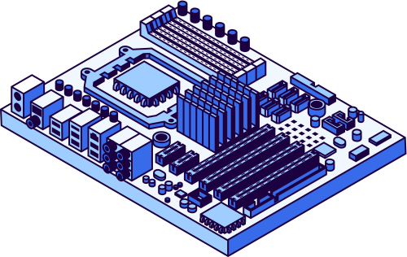
Project
2025
Applied Human Computer Interaction
REDESIGNING CLASH ROYALE WITH HCI CONCEPTS
CLASH ROYALE
Build By a Professional Software Team
Muhammad Shayan Faisal
Hamza Ahmed
Bahadur Ali
Muhammad Sufyan Ali

Slide 2



Project
2025
Explanation of Project
Overview:
This project focuses on improving the user interface of Clash Royale
Goal is to enhance usability, accessibility, and user experience
Approach:
Identified usability issues in existing UI
Applied HCI principles for redesign
Created improved UI screens
Performed usability evaluation
Key Improvements:
Simplified and clean interface
Better visual hierarchy
Consistent navigation system
Reduced cognitive load

Slide 3




Project
2025
Game Selection & Problem Justification
Clash Royale is a popular strategy game
Contains complex interface and multiple features
High cognitive load for new users
UI lacks clarity and consistency
Strong potential for usability improvement

Slide 4




Project
2025
Usability Problems Identification
Cluttered interface with too many elements
Poor visual hierarchy
Small buttons causing misclicks
Confusing navigation
High cognitive load
Weak system feedback

Slide 5



Project
2025
Application of HCI Principles
Consistency
Same color scheme (dark blue + orange highlights)
Uniform button styles and icons
Consistent bottom navigation bar
Visual Hierarchy
Primary action (Battle button) is large and centered
Important sections are clearly separated
Use of size, color, and spacing to guide attention
Cognitive Load Reduction
Reduced clutter by grouping related elements
Removed unnecessary visual noise
Simplified card layout
User Control & Freedom
Easy navigation via bottom menu
Clear back/forward actions
Logical screen transitions

